Slide 1
At the end of the day, a programming language is a tool developed by humans and, humans are weird!
- Dennis Ritchie

Slide 2
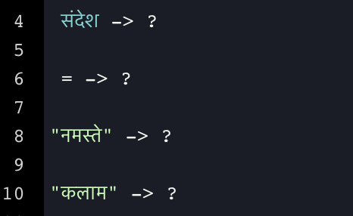
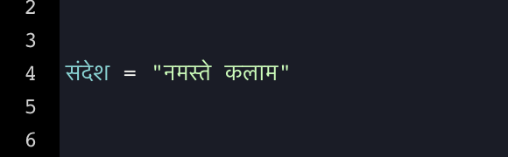
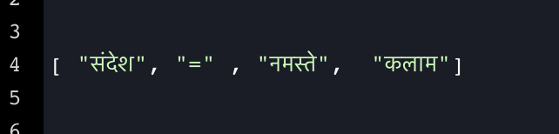
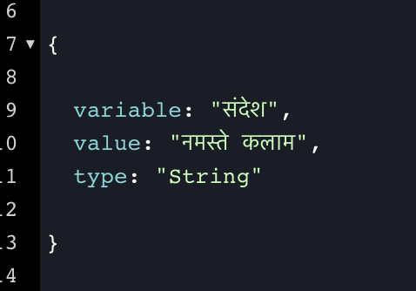
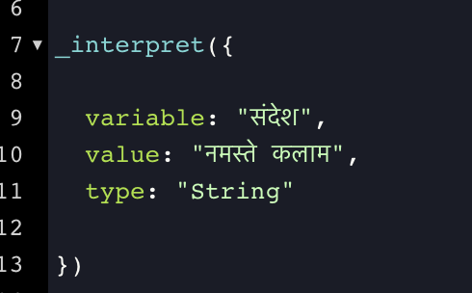
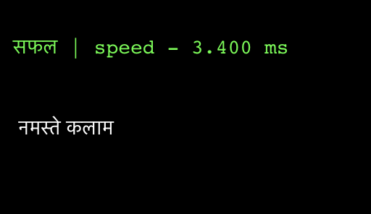
CODE
Tokenizer
Parser
Parse Tree
Interpreter
Output

Slide 3
At the end of the day, a programming language is a tool developed by humans and, humans are weird!
- Dennis Ritchie

Slide 4
Advanced Javascript
Day 1 - Js Data Types

Slide 5
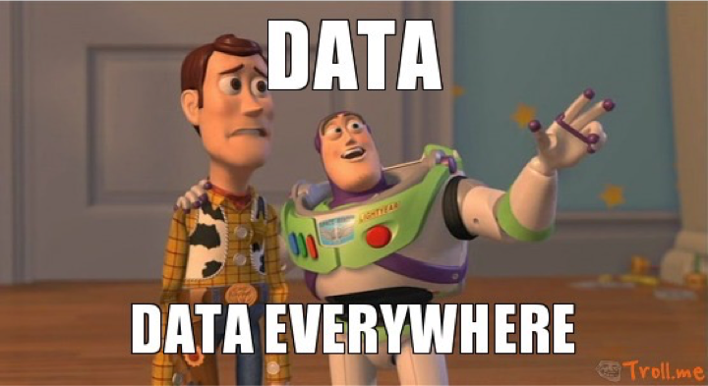
Inside the computer’s world. There is only data.

Slide 6

What would be your first step to understand and work with such data without getting lost?

Slide 7

Categorization. Separating things into Types.

Slide 8
I have a question for you!

Slide 9
Programming language is the one who understands whether we want 2+5 or “two”+”five”.

Slide 10
There are 5 primitive data types in Js and 3 Non-primitive.

Slide 11
What is primitive?
being the first or earliest of the kind or in existence

Slide 12
Primitive DataType

Slide 13

In computer science, primitive data type is a basic type provided by a programming language as a basic building block.
Like a brick is to a building.

Slide 14
String
As the name suggests, the string is for a sequence of characters, for example, “demo”, “Hi”, etc.
Boolean
It has two values i.e True or False.
Number
Number represents numerical values such as 5, 20, 500, etc.
Undefined
Undefined value
Null
Null value

Slide 15
Numbers and Js
JavaScript has a built-in Math methods which contains a small library of mathematical functions.

Slide 16
Math.floor
Rounds down: 3.1 becomes 3, and -1.1 becomes -2.
Math.ceil
Rounds up: 3.1 becomes 4, and -1.1 becomes -1.
Math.round
Rounds to the nearest integer: 3.1 becomes 3, 3.6 becomes 4, the middle case: 3.5 rounds up to 4 too.
Math.trunc (not supported by Internet Explorer)
Removes anything after the decimal point without rounding: 3.1 becomes 3, -1.1 becomes -1.

Slide 17
Math.random()
Math.max(a, b, c...) / Math.min(a, b, c...)
Math.pow(n, power)

Slide 18
In JavaScript, the textual data is stored as strings.
Strings can be enclosed within either ‘single quotes’, “double quotes” or `backticks`.

Slide 19
Strings and Js
Finding length of a String
Accessing Characters (charAt)
Changing the case
Substring
Includes, startsWith, endsWith
split
For more - https://developer.mozilla.org/en-US/docs/Web/JavaScript/Reference/Global_Objects/String

Slide 20
Boolean

Slide 21
Boolean has only two values in any programming language True & False.
It decides if the expression is true or false in if-else, while, for-loop blocks and according to that certain part of code gets executed.

Slide 22
Null

Slide 23

NULL is a value.
You assign this value to the variable or object to wipe out all the data in it.
It’s just a special value which represents “nothing”, “empty” or “value unknown”.

Slide 24
Undefined

Slide 25
The special value undefined also stands apart. It makes a type of its own, just like null.
The meaning of undefined is “value is not assigned”.
If a variable is declared, but not assigned, then its value is undefined:

Slide 26
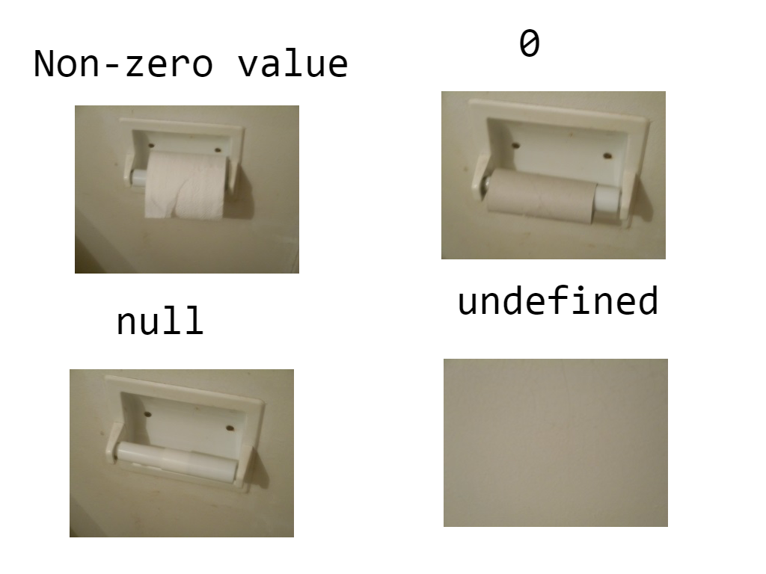

Slide 27
Non- Primitive Data Types

Slide 28
Object
Collection of key value pairs.
Array
Storing multiple values as a long list.
function
Executes a block of code.

Slide 29
By Value and By Reference

Slide 30
Assignments in Js
Primitive Data Type ( String, Number, Boolean etc)
They hold the actual value.
Non-primitive Data type ( Objects, Array, functions )
They hold the location of value.

Slide 31
It’s all about how Js handles the data it is has to store.
It’s called Memory Management.

Slide 32
In Js,
Primitive Datatypes: By Value
Non-Primitive Datatypes: By reference
Let’s see some examples...

Slide 33
Reassignments

Slide 34
By value
The original variable is not modified on changes in other variables.
By reference
The original variable gets modified on changes in other variables.

Slide 35
Data Mutability

Slide 36
What is Mutability()?
To be able to change or modify something.

Slide 37
In Js,
Primitive Data Types : Immutable ( value cannot be changed in memory )
Non- Primitive Data Types: Mutable ( value can be changed in memory )

Slide 38
Remember:
Mutability refers to changing the value itself and not the value of variable.
Variable by its name and nature is supposed to be changed throughout a computer program.

Slide 39
What are the benefits of Immutability?

Slide 40
Predictability
Predictable code is code where you can anticipate the outcome with a single read

Slide 41
Tracking Mutations
Immutable data gives you a clear history of the program, because you're creating a new reference based on the source.

Slide 42
What are the drawbacks of Immutability?
Well, it depends….

Slide 43
Immutability isn’t free, every time we have to reallocate a new value, that's consuming CPU time and memory, including the garbage collection process for values that are no longer referenced.

Slide 44
But if you compare it with the fact that you have to write more code, create more copies and things can get really hard to know who changed who.
You will appreciate Immutability.

Slide 45
For everything that looks easy, there lies an underlying force doing the hard work for you.
Dr. Homi Bhabha

Slide 46
Conclusion
If your app is small, doesn’t change a lot of values and have less reference to each other, you can avoid Immutability.
If your app is big, changes a lot of values and have complex references amongst them, Immutability can save your life!

Slide 47
Let’s Recap
By Value - ( a=b)
By Reference - a b
a
b
Data

Slide 48


Mutability -
Immutability -

Slide 49
How Javascript works

Slide 50
What is your name?
你叫什麼名字？
¿Cuál es tu nombre?

Slide 51
Behind every language, there lies a processing engine to understand it.
For humans, its Brain.
For computers, it’s Compiler.

Slide 52
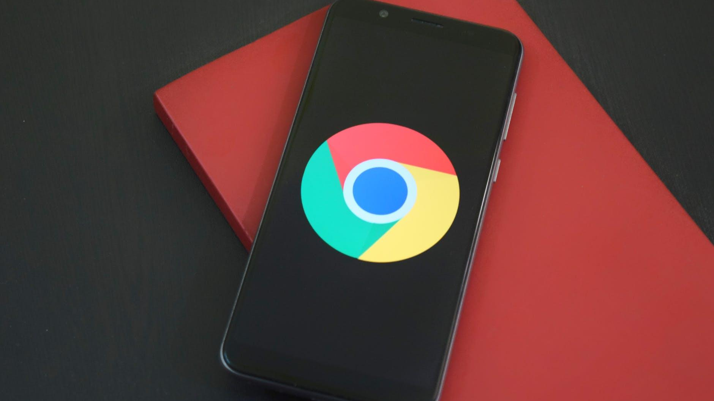
Js Engines

Slide 53
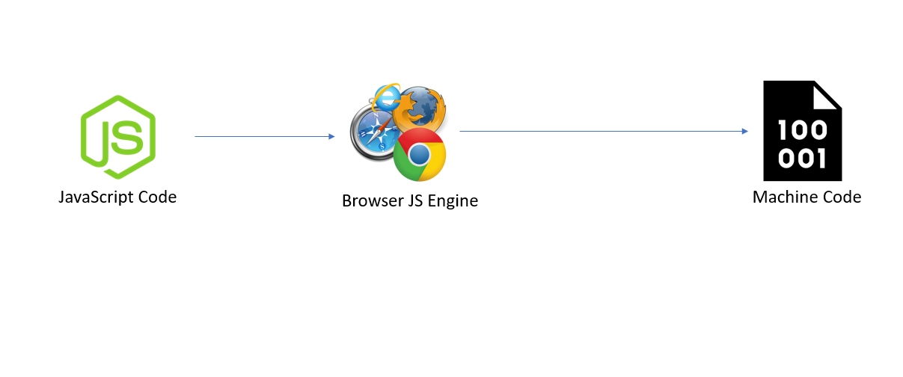
Wherever Js is used, there exist a JS engine helping computer to understand the code you wrote.

Slide 54
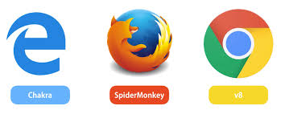

Slide 55
If there are different Js engines understanding my code differently, do I have to write different Js code for each one of them?

Slide 56
Next time you get an error while writing Js, just know that Js engine is doing it’s job of helping you and the computer communicate in a proper way.

Slide 57

How does that process looks like?

Slide 58
Hoisting

Slide 59

Hoist
To Raise

Slide 60

Hoisting helps keep the attendance sheet of a Javascript Program.

Slide 61
var name = “Raj” //Declaration and Assignment
Becomes
var name; // Declaration
name=”Raj” // Assignment

Slide 62
Hoisting only applies to Variables and functions.
Also, it only considers declaration part and not the actual assignment.

Slide 63

All hoisting cares about is what variables and functions are present in a program.

Slide 64

Execution Context

Slide 65

Context
background, environment, or surroundings of events or occurrences.

Slide 66
Execution Context
Environment in which the JavaScript code is executed.
By environment, I mean the value of this, variables, objects, and functions JavaScript code has access to at a particular time.

Slide 67
Depending upon which part of code Js is running, execution context changes.
It might seem complex but it changes only when it is running a code inside of a function.

Slide 68
Types of Execution Context:
Global Execution Context
Functional Execution Context

Slide 69
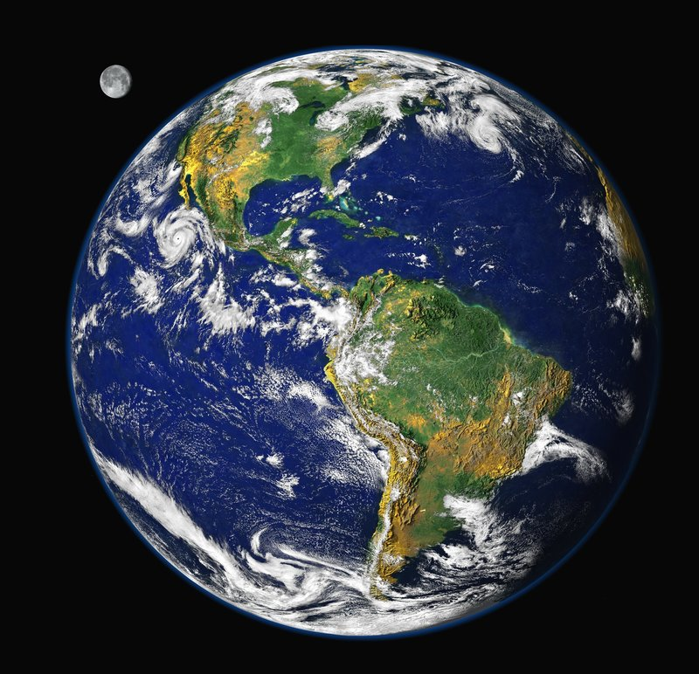
Global Execution Context

Slide 70
This is the default execution context in which JS code start its execution when the file first loads in the browser.

Slide 71

Functional Execution Context

Slide 72
Functional execution context is defined as the context created by the JS engine whenever it finds any function call.

Slide 73
When a JavaScript engine executes a script, it creates execution contexts. Each execution context has two phases:
Creation phase
Execution phase.

Slide 74
During this creation phase, it performs the following tasks:
Create a global object i.e., window in the web browser.
Create a ‘this’ object which points to the global object above.
Setup a memory for storing variables, objects etc.
Hoisting

Slide 75
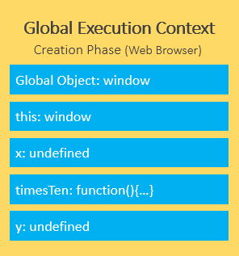
var x = 10;
function timesTen(a){
return a * 10;
}
var y = timesTen(x);
console.log(y); // 100

Slide 76
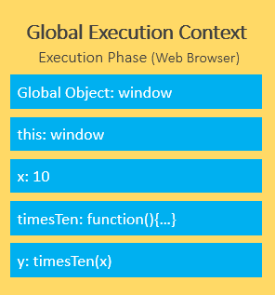
During the execution phase, the JavaScript engine executes the code line by line. In this phase,
It assigns values to variables
Executes the function calls.

Slide 77
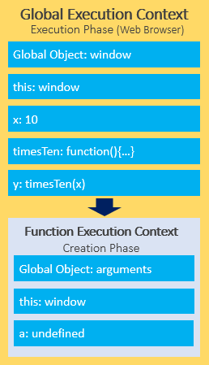
For every function call, the JavaScript engine creates a new Function Execution Context.

Slide 78
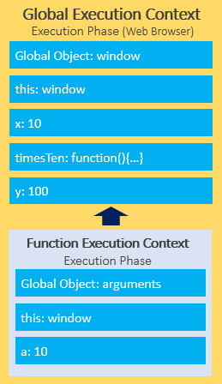
Communication between Global and Functional execution context.

Slide 79
To keep track of all the execution contexts including the Global Execution Context and Function Execution Contexts, the JavaScript engine uses a data structure named Execution stack.

Slide 80

Execution Stack

Slide 81
JavaScript engine uses a call stack to manage execution contexts: the Global Execution Context and Function Execution Contexts.
The call stack works based on the LIFO principle i.e., last-in-first-out.

Slide 82
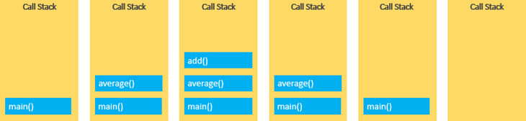
function main()
{
average()
}
function add()
{
}
function average()
{
add()
}
main()

Slide 83
Variable Scope

Slide 84

Scope
Range or Coverage.

Slide 85
What is Variable Scope in Js?
Scope determines the visibility and accessibility of a variable. JavaScript has three scopes:
Global scope
Local scope
Block scope.

Slide 86
Global Scope
When you execute a script, the JavaScript engine creates a global execution context.
It also assigns variables that you declare outside of functions to the global execution context. These variables are in the global scope.
They are also known as global variables.

Slide 87
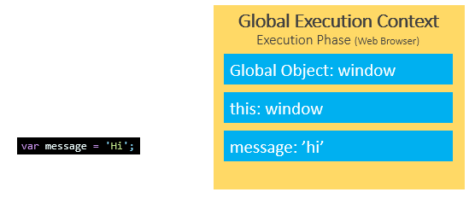

Slide 88
Local Scope
Variables that you declare inside a function are local to that function.
They are called Local Variables and can’t be accessed in Global Scope.

Slide 89
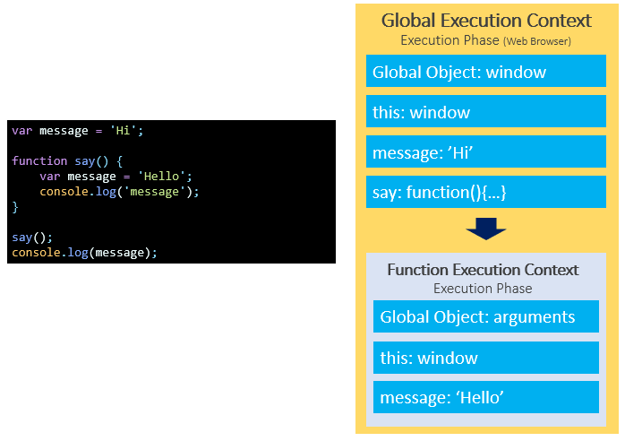

Slide 90
Scope Chain

Slide 91
Global Scope
JavaScript resolves a variable by looking it in its current scope, if it cannot find the variable, it goes up to the outer scope, is called the scope chain.

Slide 92
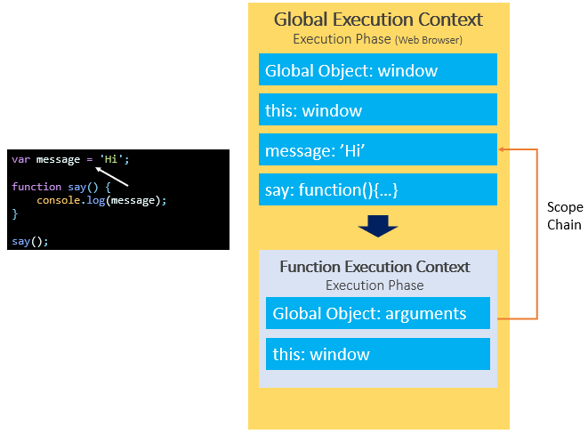

Slide 93

Let’s Recap
Hoisting -

Slide 94

Context

Slide 95

Execution context

Slide 96

Execution Stack

Slide 97

Scope chain

